Slide 1

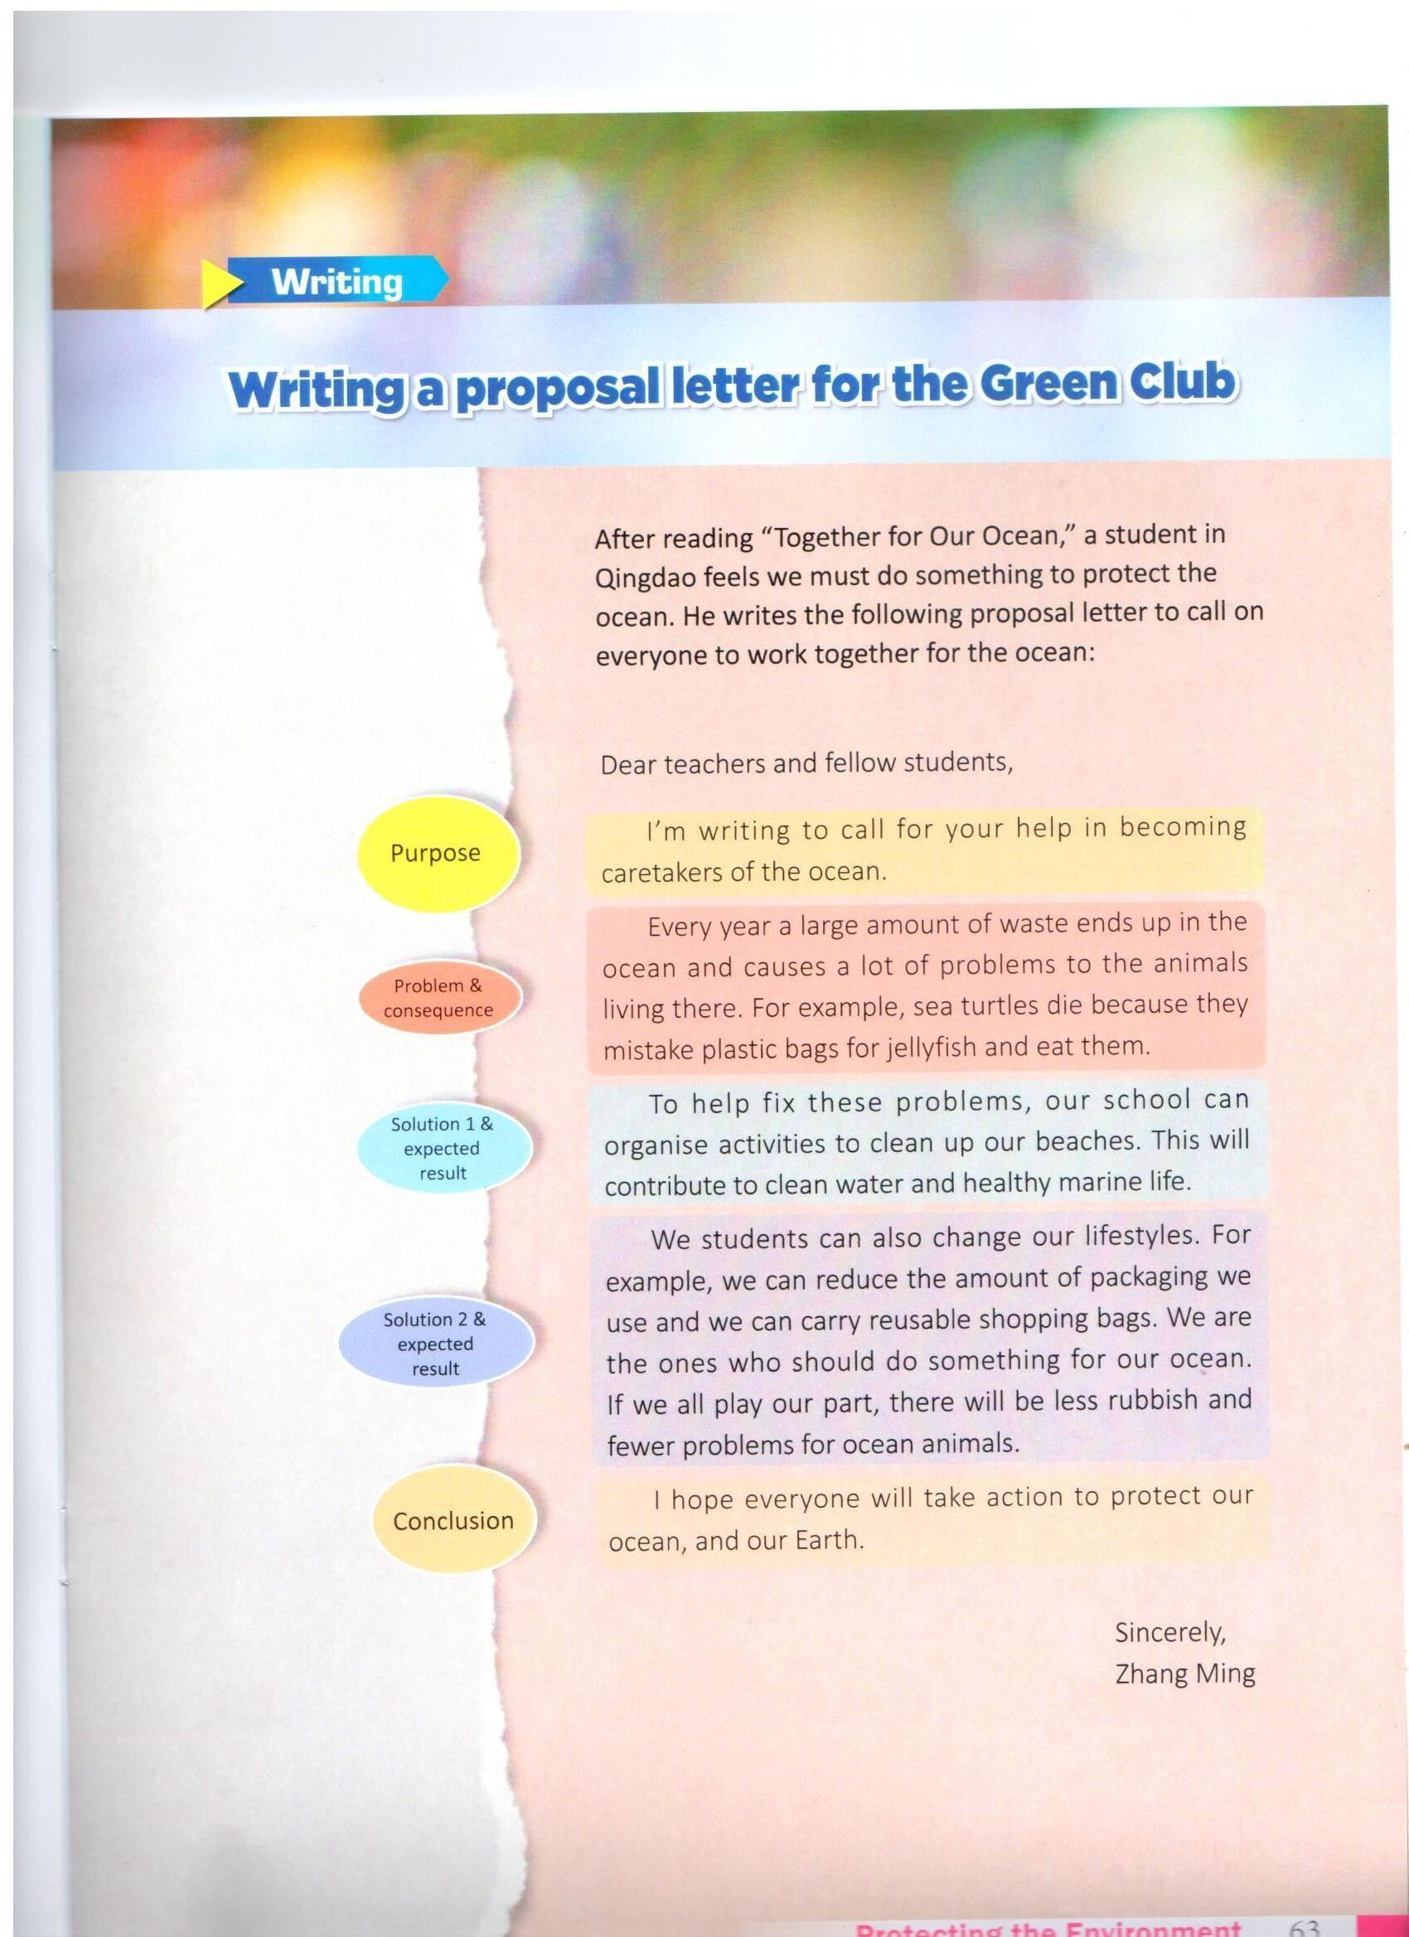





Elements of a proposal letter
Paragraph 1
Paragraph 2
Paragraph 3
Paragraph 4
Paragraph 5

Slide 2










Paragraph 1

Slide 3










Paragraph 2
cause damage to ...
for example

Slide 4

Paragraph 5
t

